Slide 1
SSW-567: Software Testing, Quality Assurance, and Maintenance
Model-Based Testing*
Raz Saremi
Software Engineering
School of Systems and Enterprises
* This lecture is based on content originally prepared by Linda Laird, and includes updates by Jim Rowland and Rich Kempinski

Slide 2

Today’s topics
Model Based Testing
Using models to automate test case generation
Decision tables and trees
Finite State Machines (FSM)
State tables and diagrams
Markov chains
Grammars

Slide 3
What is a model?
What is a model?
“A model is a representation that is simpler than the artifact it represents but preserves (or at least approximates) some important attributes of the actual artifact.”
How does it help testing?
The model of the SUT (System Under Test) can be used as the testing oracle, which may be complete or incomplete
Source: Pezza and Young, Software Testing and Analysis: Process, Principles and Techniques

Slide 4
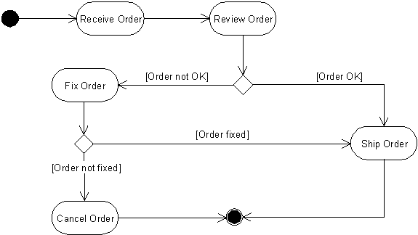
Simple Model

Slide 5
What is Model-Based Testing (MBT)?
Testing technique where the SUT is compared to a formal model created from the SUT’s requirements*
Use a formal model of the SUT along with test generation tools to automatically generate relevant test cases
Test case results from the SUT are compared against the Model’s expected results → the Model becomes the Oracle
Models may be formal or informal
Model of System Under Test
Test Generation Tool
System Under Test
Test Cases
Test Results
* Automatic Model-based test generation from UML state machines from Model-based Testing for Embedded Systems, 2012, CRC Press

Slide 6
MBT advantages/disadvantages
Advantages
Automate test case design & test case generation
More extensive testing possible
Disadvantages
Requires a formal model
Models may be difficult to organize & develop
Changes to the model changes can be tested easily
Effort moves from testing to building the model
Generating the model improves understanding of the SUT
Helps with validating requirements early on
Scaling may become an issue
May reduce cost
More traceability from model to test cases
Easier maintenance of regression tests
Models may be difficult to comprehend
QA confidence depends upon the accuracy of the model

Slide 7
Types of models
Structural Models
Model the structure of the system
What the system is
Describes the components, functionality, and interactions
Behavioral Models ✔
Model the behavior of the system
What the system does; not how it does it
Needed for testing

Slide 8
Strategies for building models
Form a mental representation of the system’s functionality
Understand the system’s behavior before modeling
Must understand inputs, outputs, actions to build a model for testing purposes
The description needs to be written down in an easily understandable form and should be as formal as practical
Useful models can make test generation easier and automatable
Many formal modeling techniques to describe behaviors
Large, complex systems may require the team to use formal modeling techniques
Source: DACS Gold Practice Document Series GP-34 V 1.1 Model-Based Testing Last Updated: 10/20/03

Slide 9
Behavior Modeling Techniques
Decision Tables
Sets of conditions and actions
Finite State Machines
States and transitions
Optional actions
Markov Chains
States, transitions, and the probability of changing state
State Charts
UML diagrams with states and events that cause state changes
Grammars
Describes valid inputs
Rules

Slide 10
Decision Tables

Slide 11
Decision Tables
A decision table lists causes (inputs and their values) and effects (results, or outputs) in a table
Each column represents a unique combination of inputs
Decision tables help to structure logic in a verifiable form
Cause → Input and its possible values
Effect → Output, i.e. the expected results
 |  | Combinations
Inputs | Values | 1 | 2 | 3 | 4 | 5 | 6 | 7 | 8
Input 1 | Y, N | Y | Y | Y | Y | N | N | N | N
Input 2 | Y, N | Y | Y | N | N | Y | Y | N | N
Input 3 | Y, N | Y | N | Y | N | Y | N | Y | N
Outputs
Effect 1 |  | X |  | X | X
Effect 2 |  |  | X |  |  |  | X | X
Source: de Wilde

Slide 12
Creating a decision table
List all inputs and their values
Calculate the number of possible combinations of input values
Fill columns with all possible combinations
Reduce test combinations
Verify covered combinations
Combine mutually exclusive inputs

Slide 13
Step 1: List all inputs and values
 |  | Combinations
Inputs | Values | 1 | 2 | 3 | 4 | 5 | 6 | 7 | 8
Input 1 | Y,N
Input 2 | Y,N
Input 3 | Y,N
Input 4 | Y,N
Effects
Write down the values the inputs can assume
Cluster related inputs
Put the most dominating input first
Put multi-valued inputs last

Slide 14
Step 1: combine mutually exclusive inputs
 |  | Combinations
Inputs | Values | 1 | 2 | 3 | 4 | 5 | 6 | 7 | 8
Input 1 | Y,N
Input 2 | Y,N
Input 3 | Y,N
Input 4 | Y,N
Effects
Say Input-3 & Input-4 are mutually exlcusive
When Input-3 is Y, Input-4 is N
And
When Input-3 is N, Input-4 is Y
Then do not need both
Combine into one input that chooses which is Y
 |  | Combinations
Inputs | Values | 1 | 2 | 3 | 4 | 5 | 6 | 7 | 8
Input 1 | Y,N
Input 2 | Y,N
Input 3or4 | 3,4
Effects

Slide 15
Step 2: Calculate total combinations
one input with 3 values and four inputs with 2 values: 3 * 2 * 2 * 2 * 2= 48
If all inputs are simply Y/N values: 2^{number of inputs}
Q: How many combinations?
A: Take the product of the number of values per input
Source: de Wilde,

Slide 16
Tip for listing all values
If you have three inputs with possible values of Y, N then think of binary numbers to help to enumerate all possible values
Binary 2² | 2¹ | 2⁰ | Decimal
0 | 0 | 0 | 0
0 | 0 | 1 | 1
0 | 1 | 0 | 2
0 | 1 | 1 | 3
1 | 0 | 0 | 4
1 | 0 | 1 | 5
1 | 1 | 0 | 6
1 | 1 | 1 | 7

Slide 17
Step 3: List all input value combinations
List all possible combinations of input values
 |  | Combinations
Inputs | Values | 1 | 2 | 3 | 4 | 5 | 6 | 7 | 8
Input 1 | Y,N | Y | Y | Y | Y | N | N | N | N
Input 2 | Y,N | Y | Y | N | N | Y | Y | N | N
Input 3 | Y,N | Y | N | Y | N | Y | N | Y | N
Effects
Effect 1 |  | X |  | X | X
Effect 2 |  |  | X |  |  |  | X | X

Slide 18
Step 4: Reduce combinations
Combine columns where the effect is the same and only one input value is different
Combine values, e.g. Y, N → YN
“Don’t Care” – the effect is the same regardless of the input value
Make sure the effects are the same. If not, they shouldn’t be combined (and – may be incorrect)
 |  | Combinations
Inputs | Values | 1 | 2 | 3 | 4 | 5 | 6 | 7 | 8
Input 1 | Y,N | Y | Y | Y | Y | N | N | N | N
Input 2 | Y,N | Y | Y | N | N | Y | Y | N | N
Input 3 | Y,N | Y | N | Y | N | Y | N | Y | N
Effects
Effect 1 |  | X |  | X | X
Effect 2 |  |  | X |  |  |  | X | X
We get the same effect with any value of Input3 when Input1=Y and Input2=N.
Input3 is a Don’t Care in that case so combine the two columns
Source: de Wilde,
Notes:
Often there are dependencies between inputs. For example input 1 can test if a field is entered (Y/N) and cause 2 can test if the same field is valid (Y/N). It is no use testing if the field is valid if it has not been entered.
Join columns: When in a column a input is of no interest any more to determine the effects, a dash ‘-’ is placed in the column for that cause. This has to be done for both the column with a ‘Y’ and the column with a ‘N’. This makes the 2 columns identical and one of them can be deleted.

Slide 19
Step 4: Reduce combinations
 |  | Combinations
Inputs | Values | 1 | 2 | 3 | 4 | 5 | 6 | 7
Input 1 | Y,N | Y | Y | Y | N | N | N | N
Input 2 | Y,N | Y | Y | N | Y | Y | N | N
Input 3 | Y,N | Y | N | - | Y | N | Y | N
Effects
Effect 1 |  | X |  | X
Effect 2 |  |  | X |  |  | X | X
We combined two columns and reduced the number from 8 to 7
‘-’ implies “Don’t Care” because the value doesn’t impact the result
Source: de Wilde,
Notes:
Often there are dependencies between causes. For example cause 1 can test if a field is entered (Y/N) and cause 2 can test if the same field is valid (Y/N). It is no use testing if the field is valid if it has not been entered.
Join columns: When in a column a cause is of no interest any more to determine the effects, a dash ‘-’ is placed in the column for that cause. This has to be done for both the column with a ‘Y’ and the column with a ‘N’. This makes the 2 columns identical and one of them can be deleted.

Slide 20
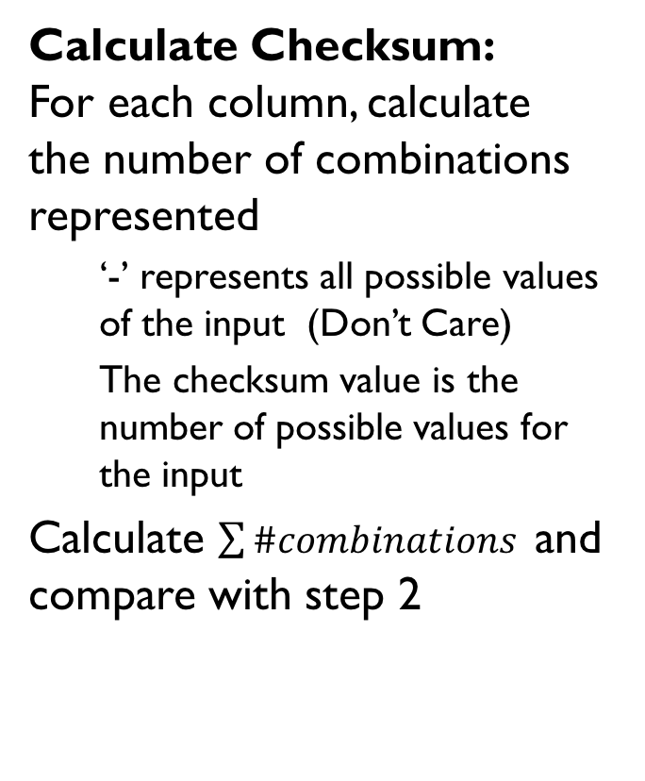
Step 5: Check covered combinations
 |  | Combinations
Inputs | Values | 1 | 2 | 3 | 4 | 5 | 6 | 7
Input 1 | Y,N | Y | Y | Y | N | N | N | N
Input 2 | Y,N | Y | Y | N | Y | Y | N | N
Input 3 | Y,N | Y | N | - | Y | N | Y | N
Effects
Effect 1 |  | X |  | X
Effect 2 |  |  | X |  |  | X | X
Checksum |  | 1 | 1 | 2 | 1 | 1 | 1 | 1
Calculate Checksum:
For each column, calculate the number of combinations represented
‘-’ represents all possible values of the input (Don’t Care)
The checksum value is the number of possible values for the input
Calculate $\sum{\#combinations }$and compare with step 2
8 Total combinations

Slide 21
Example: Customer decision table
Requirements:
A mailing is to be sent to customers. The content of the mailing describes the current discounts and potential additional discounts. The content of the mailing is different for different types of customers:
Customer Types A and B get a normal letter
Customer Type C gets a special letter
Any customer with two or more current lines of credit or with a credit rating of at least 600 gets an offer with additional discounts
Notes:
Ask questions from the analyst for clarification

Slide 22
Mailing example: Build a Model
Are the requirements clear, concise, and complete?
No? Building a model may help to disambiguate
Step 1: Start with Inputs and Outputs
Inputs:
Customer type: {A, B, C}
Credit rating 600+: {Y, N}
Current Lines of Credit 2+: {Y,N}
Outputs:
Letter type: {Normal, Special, Normal+Discount, Special+Discount}
Ambiguities and Assumptions:
Does the special letter apply to all customer types or just customer type C? – Assume only customer type C is eligible for the special letter
Are there other types of customers? – Assume No
Are there other credit ratings or lines of credit? - Assume No

Slide 23
Example:
Step 2: Calculate the total possible combinations
Inputs:
Customer type: {A, B, C}
Credit rating 600+: {Y, N}
Current Lines of Credit 2+: {Y,N}
3 customer types
* 2 credit ratings
* 2 line of credit values == 12 combinations

Slide 24
Step 3: Fill in Results with All Combinations
 |  |  | Combinations
Inputs |  | Values
Customer Type |  | A, B, C | A | A | A | A | B | B | B | B | C | C | C | C
 | 2+ Lines of Credit | Y, N | Y | Y | N | N | Y | Y | N | N | Y | Y | N | N
 | Credit Rating 600+ | Y, N | Y | N | Y | N | Y | N | Y | N | Y | N | Y | N
Results
 | Normal Letter |  |  |  |  | Y |  |  |  | Y
 | Special Letter |  |  |  |  |  |  |  |  |  |  |  |  | Y
 | Normal + Discount |  | Y | Y | Y |  | Y | Y | Y
 | Special + Discount |  |  |  |  |  |  |  |  |  | Y | Y | Y
Now we have an unambiguous specification that can be reviewed with the stakeholder to ensure it is what was intended – and can be turned into test cases easily.

Slide 25
Step 4.1: Reduce from 12 to 8
 |  |  | Combinations
Inputs |  | Values
 | Customer Type | A,B,C | A | A | A | A | B | B | B | B | C | C | C | C
 | 2+ Lines of Credit | Y,N | Y | Y | N | N | Y | Y | N | N | Y | Y | N | N
 | Credit Rating 600+ | Y,N | Y | N | Y | N | Y | N | Y | N | Y | N | Y | N
Results
 | Normal Letter |  |  |  |  | Y |  |  |  | Y
 | Special Letter |  |  |  |  |  |  |  |  |  |  |  |  | Y
 | Normal+Discount |  | Y | Y | Y |  | Y | Y | Y
 | Special+Discount |  |  |  |  |  |  |  |  |  | Y | Y | Y
The model shows that we have the same results for A and B, regardless of the values of the other inputs, so we can collapse the values for A and B and reduce the size of the matrix

Slide 26
Step 4.2: Reduce from 12 to 8
 |  |  | Combinations
Inputs |  | Values
 | Customer Type | AB, C | AB | AB | AB | AB | C | C | C | C
 | 2+ Lines of Credit | Y, N | Y | Y | N | N | Y | Y | N | N
 | Credit Rating 600+ | Y, N | Y | N | Y | N | Y | N | Y | N
Results
 | Normal Letter |  |  |  |  | Y
 | Special Letter |  |  |  |  |  |  |  |  | Y
 | Normal+Discount |  | Y | Y | Y
 | Special+Discount |  |  |  |  |  | Y | Y | Y
The model shows that we have the same results for A and B so we collapse the A and B values and reduce the size of the matrix from 12 combinations to 8 combinations.

Slide 27
Step 4.3: Reduce from 8 to 6
 |  |  |  | Combinations
Inputs |  |  | Values
 | Customer Type |  | AB, C | AB | AB | AB | AB | C | C | C | C
 | 2+ Lines of Credit |  | Y, N | Y | Y | N | N | Y | Y | N | N
 | Credit Rating 600+ |  | Y, N | Y | N | Y | N | Y | N | Y | N
Results
 | Normal Letter |  |  |  |  |  | Y
 | Special Letter |  |  |  |  |  |  |  |  |  | Y
 | Normal + Discount |  |  | Y | Y | Y
 | Special + Discount |  |  |  |  |  |  | Y | Y | Y
Customer Type == AB with 2+ Lines of credit == Y have the same result regardless of Credit Rating 600+ so reduce
Customer Type == C with 2+ Lines of credit == Y have the same result regardless of Credit Rating 600+ so reduce

Slide 28
Step 4.4: Reduce Farther
 |  |  |  | Combinations
Inputs |  |  | Values
 | Customer Type |  | AB, C | AB | AB | AB | C | C | C
 | 2+ Lines of Credit |  | Y, N | Y | N | N | Y | N | N
 | Credit Rating 600+ |  | Y, N | - | Y | N | - | Y | N
Results
 | Normal Letter |  |  |  |  | Y
 | Special Letter |  |  |  |  |  |  |  | Y
 | Normal+Discount |  |  | Y | Y
 | Special+Discount |  |  |  |  |  | Y | Y
We’ve reduced from 12 to 6. Can we reduce further?

Slide 29
Step 4.4: Reduce Farther
 |  |  | Combinations
Inputs |  | Values
 | Customer Type | AB,C | AB | AB | AB | C | C | C
 | 2+ Lines of Credit | Y,N | Y | N | N | Y | Y | N
 | Credit Rating 600+ | Y,N | - | Y | N | Y | - | N
Results
 | Normal Letter |  |  |  | Y
 | Special Letter |  |  |  |  |  |  | Y
 | Normal+Discount |  | Y | Y
 | Special+Discount |  |  |  |  | Y | Y
Customer Type == AB and (2+ Lines of Credit == Y or Credit Rating 600+ == Y) have same result so reduce
Customer Type == C and (2+ Lines of Credit == Y or Credit Rating 600+ ==Y) have same result so reduce

Slide 30
Step 4.5: Reduce Farther
 |  |  | Combinations
Inputs |  | Values
 | Customer Type | AB,C | AB | AB | C | C
 | 2+Lines of Credit or Credit Rating 600+ | Y,N | Y | N | Y | N
Results
 | Normal Letter |  |  | Y
 | Special Letter |  |  |  |  | Y
 | Normal + Discount |  | Y
 | Special + Discount |  |  |  | Y
We’ve reduced the model from 12 combinations to 4 and fully specified the model without ambiguity! The model is now smaller and easier to understand.

Slide 31
Verify Checksums (Before)
 |  |  | Combinations
Inputs |  | Values
 | Customer Type | A,B,C | A | A | A | A | B | B | B | B | C | C | C | C
 | 2+ Lines of Credit | Y,N | Y | Y | N | N | Y | Y | N | N | Y | Y | N | N
 | Credit Rating 600+ | Y,N | Y | N | Y | N | Y | N | Y | N | Y | N | Y | N
Results
 | Normal Letter |  |  |  |  | Y |  |  |  | Y
 | Special Letter |  |  |  |  |  |  |  |  |  |  |  |  | Y
 | Normal+Discount |  | Y | Y | Y |  | Y | Y | Y
 | Special+Discount |  |  |  |  |  |  |  |  |  | Y | Y | Y
Checksum |  |  | 1 | 1 | 1 | 1 | 1 | 1 | 1 | 1 | 1 | 1 | 1 | 1

Slide 32
Verify Checksums (After)
 |  |  | Combinations
Inputs |  | Values
 | Customer Type | AB,C | AB | AB | C | C
 | 2+ Lines of Credit or Credit Rating 600+ | Y,N | Y | N | Y | N
Results
 | Normal Letter |  |  | Y
 | Special Letter |  |  |  |  | Y
 | Normal + Discount |  | Y
 | Special + Discount |  |  |  | Y
Checksum (Number of combinations) |  |  | 6 | 2 | 3 | 1
The checksum reflects the number of original combinations covered by each column

Slide 33
More Decision Table examples
See: https://www.youtube.com/watch?v=ED2iJXkdhCQ
Printer repair decision tree model
Note that the format has changed slightly –
The causes are now conditions and the effects are now actions….
In this example – no checksum

Slide 34
Printer Repair Example
 |  |  | Combinations
Inputs |  | Values
 | Printer does not print | Y,N | Y | Y | Y | Y | N | N | N | N
 | Red light flashing | Y,N | Y | Y | N | N | Y | Y | N | N
 | Printer is unrecognized | Y,N | Y | N | Y | N | Y | N | Y | N
Results
 | Check power cable |  |  |  | Y
 | Check printer-computer cable |  | Y |  | Y
 | Ensure printer software is installed |  | Y |  | Y |  | Y |  | Y
 | Check/replace ink |  | Y | Y |  |  | Y | Y
 | Check for paper jam |  |  | Y |  | Y
Can we make any reductions?

Slide 35
Printer Repair Example
 |  |  | Combinations
Inputs |  | Values
 | Printer does not print | Y,N | Y | Y | Y | Y | N | N | N | N
 | Red light flashing | Y,N | Y | Y | N | N | Y | Y | N | N
 | Printer is unrecognized | Y,N | Y | N | Y | N | Y | N | Y | N
Results
 | Check power cable |  |  |  | Y
 | Check printer-computer cable |  | Y |  | Y
 | Ensure printer software is installed |  | Y |  | Y |  | Y |  | Y
 | Check/replace ink |  | Y | Y |  |  | Y | Y
 | Check for paper jam |  |  | Y |  | Y
Can we make any reductions? No – no two combinations have the same result

Slide 36
Why use Decision Tables
Decision tables make it easy to observe that all possible conditions are accounted for
Obvious if conditions are omitted compared to traditional control structures
Decision tables make you consider all possible conditions
An excellent tool for designing control logic
E.g. after a failed 6 staff-year attempt to describe program logic for a file maintenance system using flow charts, four people solved the problem using decision tables in just four weeks

Slide 37
How do decision tables improve testing and quality?
Improved specification visibility
Improved test case visibility
Able to generate code from decision tables
For oracles
For actual systems

Slide 38
Decision Tree
Decision tables can be represented in a tree structure
Customer Type |  | AB,C | AB | AB | C | C
 | 2+ Lines of Credit or Credit Rating 600+ | Y,N | Y | N | Y | N
Results
 | Normal Letter |  |  | Y
 | Special Letter |  |  |  |  | Y
 | Normal + Offer |  | Y
 | Special + Offer |  |  |  | Y
Customer Type?
AB
C
2+lines of credit or credit rating 600+?
2+lines of credit or credit rating 600+?
Y
N
Y
N
Normal + Discount
Normal Letter
Special + Discount
Special Letter

Slide 39
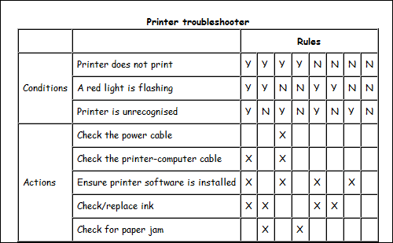
Exercise: Create a decision tree for the printer example

Slide 40
Exercise: Medical Insurance Decision Table
No charges are reimbursed to a patient until the deductible has been met.
After the deductible has been met, the amount to be reimbursed depends on whether or not the doctor or hospital is a “preferred provider”.
For preferred providers, doctor’s office visits are reimbursed at 55% and hospital visits are reimbursed at 95%.
For other providers, reimburse 40% for doctor’s office visits and 70% for hospital visits.
Visit Type?

Slide 41
Medical Insurance Decision Table
No charges are reimbursed to the patient until the deductible has been met. After the deductible has been met, the amount to be reimbursed depends on whether or not the doctor or hospital is a “preferred provider”. For preferred providers, doctor’s office visits are reimbursed at 55% and hospital visits are reimbursed at 95%. For other providers, reimburse 40% for doctor’s office visits and 70% for hospital visits.
 | Values | 1 | 2 | 3 | 4 | 5 | 6 | 7 | 8
Met Deductible | {Y,N} | N | N | N | N | Y | Y | Y | Y
Preferred Provider | {Y,N} | N | N | Y | Y | N | N | Y | Y
Visit Type | {D,H} | D | H | D | H | D | H | D | H
Results
Reimburse 0% |  | Y | Y | Y | Y
Reimburse 40% |  |  |  |  |  | Y
Reimburse 55% |  |  |  |  |  |  |  | Y
Reimburse 70% |  |  |  |  |  |  | Y
Reimburse 95% |  |  |  |  |  |  |  |  | Y
Visit Type?

Slide 42
Can we reduce?
 | Values | 1 | 2 | 3 | 4 | 5 | 6 | 7 | 8
Met Deductible | {Y,N} | N | N | N | N | Y | Y | Y | Y
Preferred Provider | {Y,N} | N | N | Y | Y | N | N | Y | Y
Visit Type | {D,H} | D | H | D | H | D | H | D | H
Results
Reimburse 0% |  | Y | Y | Y | Y
Reimburse 40% |  |  |  |  |  | Y
Reimburse 55% |  |  |  |  |  |  |  | Y
Reimburse 70% |  |  |  |  |  |  | Y
Reimburse 95% |  |  |  |  |  |  |  |  | Y
Visit Type?

Slide 43
Can we reduce?
 | Values | 1 | 2 | 3 | 4 | 5 | 6 | 7 | 8
Met Deductible | {Y,N} | N | N | N | N | Y | Y | Y | Y
Preferred Provider | {Y,N} | N | N | Y | Y | N | N | Y | Y
Visit Type | {D,H} | D | H | D | H | D | H | D | H
Results
Reimburse 0% |  | Y | Y | Y | Y
Reimburse 40% |  |  |  |  |  | Y
Reimburse 55% |  |  |  |  |  |  |  | Y
Reimburse 70% |  |  |  |  |  |  | Y
Reimburse 95% |  |  |  |  |  |  |  |  | Y
Combine 1 & 2, 3 & 4
 | Values | 1 | 2 | 3 | 4 | 5 | 6
Met Deductible | {Y,N} | N | N | Y | Y | Y | Y
Preferred Provider | {Y,N} | N | Y | N | N | Y | Y
Visit Type | {D,H} | - | - | D | H | D | H
Results
Reimburse 0% |  | Y | Y
Reimburse 40% |  |  |  | Y
Reimburse 55% |  |  |  |  |  | Y
Reimburse 70% |  |  |  |  | Y
Reimburse 95% |  |  |  |  |  |  | Y
Visit Type?

Slide 44
Can we reduce?
 | Values | 1 | 2 | 3 | 4 | 5 | 6
Met Deductible | {Y,N} | N | N | Y | Y | Y | Y
Preferred Provider | {Y,N} | N | Y | N | N | Y | Y
Visit Type | {D,H} | - | - | D | H | D | H
Results
Reimburse 0% |  | Y | Y
Reimburse 40% |  |  |  | Y
Reimburse 55% |  |  |  |  |  | Y
Reimburse 70% |  |  |  |  | Y
Reimburse 95% |  |  |  |  |  |  | Y

Slide 45
Can we reduce?
 | Values | 1 | 2 | 3 | 4 | 5 | 6
Met Deductible | {Y,N} | N | N | Y | Y | Y | Y
Preferred Provider | {Y,N} | N | Y | N | N | Y | Y
Visit Type | {D,H} | - | - | D | H | D | H
Results
Reimburse 0% |  | Y | Y
Reimburse 40% |  |  |  | Y
Reimburse 55% |  |  |  |  |  | Y
Reimburse 70% |  |  |  |  | Y
Reimburse 95% |  |  |  |  |  |  | Y
 | Values | 1 | 2 | 3 | 4 | 5
Met Deductible | {Y,N} | N | Y | Y | Y | Y
Preferred Provider | {Y,N} | N | N | N | Y | Y
Visit Type | {D,H} | - | D | H | D | H
Results
Reimburse 0% |  | Y
Reimburse 40% |  |  | Y
Reimburse 55% |  |  |  |  | Y
Reimburse 70% |  |  |  | Y
Reimburse 95% |  |  |  |  |  | Y
Total Combinations = 2 * 2 * 2 = 8
Minimum number of test cases = 5

Slide 46
State Machines

Slide 47
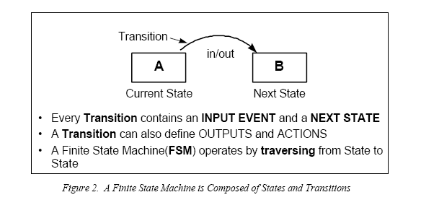
FSM – Finite State Machines

Slide 48
Garage Door FSM
States: Open, Opening, closed, closing
Sensor Readings: Open, closed
Commands: Open, close
Transitions:
Open
Sensor:Open
Command:close
Opening
Command:Open
closing
Command:close
Command:Open
Sensor:closed
closed
FSM is specified by inputs, states, and transition functions
In this case, no output or action has been specified

Slide 49
Garage Door FSM with Outputs/Actions
Open: turn off motor
Sensor:Open
Command:close
Opening: turn on motor - up
Command:Open
Closing: turn on motor - down
Command:close
Command:Open
Closed: turn off motor
Sensor:closed

Slide 50
State Table
Every FSM state transition diagram has a corresponding state table
Garage Door Opener State table
Each cell may also specify actions
Actions
 | Command: Close | Command: Open | Sensor: Open | Sensor: Closed
Closed |  | Opening
Open | Closing
Opening | Closing |  | Open
Closing |  | Opening |  | Closed
States

Slide 51
Test Cases from the State Diagram/Table
Easily create test cases from the state table
How would you test it?
Test all of the possible combinations
Remember: In a FSM model, the transition is based purely on the current state, and the input. Therefore, all states and all inputs should give complete coverage.
Garage Door Opener State Table
States\Inputs | Command Close | Command Open | Sensor Open | Sensor Closed
Closed |  | Opening
Open | Closing
Opening | Closing |  | Open
Closing |  | Opening |  | Closed

Slide 52
Garage Door Example
What’s missing from this state table that’s needed for testing?
We need to test all possible combinations
What do you need to do?
Specify all of the possible transitions
Fill in the missing blanks to avoid ambiguity
How many test cases? 4x4 = 16
States\Inputs | Command: Close | Command: Open | Sensor: Open | Sensor: Closed
Closed |  | Opening
Open | Closing
Opening | Closing |  | Open
Closing |  | Opening |  | Closed
Notes:
Lots of undefined actions – get them either defined as errors or ignore or something – you need to know what to do

Slide 53
Translating to Test Cases
The information in the state table can now be easily translated into a set of test cases: (8 out of 16 listed) and we can resolve ambiguities
Test case ID | Current state | Command/ Sensor | Action | Next state
T-200 | Open | Command Close | Start motor Down | Closing
T-201 | Open | Command Open | nothing | Open
T-202 | Open | Sensor Open | nothing | Open
T-203 | Open | Sensor Closed | Error (???!!!) | Open (???!)
T-204 | Closing | Command Close | nothing | Closing
T-205 | Closing | Command Open | Change motor to Open | Opening
T-206 | Closing | Sensor Open | Error (??) | Closing (?)
T-207 | Closing | Sensor Closed | Stop motor | Closed

Slide 54
How many test cases to test transitions?
For state/transition coverage, need as many as arrows – assuming you can figure out how to reach them all
Notes:
Well – for “state/transition coverage,

Slide 55
How would we create tests?
Would like to be able to easily test the individual transitions with unit test cases
→ need test primitives
Notes:
Well – for “state/transition coverage,

Slide 56
FSM Test Primitives
One technique for testing state machines is to use test primitives that test every individual state transition
initialize system to desired Start state
for each state S:
for each stimulus T on S:
Apply stimulus T to the system
Did the system respond as expected?
Log results
What percentage coverage do we achieve?

Slide 57
Class Example: Stopwatch
Develop test cases for a Stopwatch application
The Stop watch can be Idle, Running, or Paused
The inputs are:
Start: continue to increment elapsed time from the currently display time. The time value increases once every second
Stop: Stop incrementing the elapsed time and display the last time value
Reset: Reset time to 0
The output is:
Time: current time value
What is the state diagram? Be sure to include the states, transitions, and actions that occur during the transitions

Slide 58
Stopwatch State Diagram
Stop //,
Reset // time=0
Start
// time = increasing value
Start
Idle
Running
Initial state
// time=0
Reset
// time = 0
Start
// time = increasing value
Stop
// time = last value
Reset
// time = 0
Paused
Stop
Circles represent the Stopwatch’s state
Arrows represent the transition from one state to another
Each arrow provides two types of information:
The first value denotes the event that causes the transition to occur
The second expression, denoted by “//”, defines the resulting action that takes place

Slide 59
Stopwatch State Table
 | Idle | Running | Paused
Start | Running // time = increasing value | Running // time = increasing value | Running // time = increasing value
Stop | Idle // | Paused // time = last value | Paused // time = last value
Reset | Idle // time = 0 | Idle // time = 0 | Idle // time = 0
State
Event

Slide 60
Translating to Test Cases Example
The information in the state table can now be easily translated into a set of test cases:
Test case ID | Current state | Event | Time output | Next state
T-200 | Idle | Start | Time=incre. value | Running
T-201 | Idle | Stop | Time = last value | Idle
T-202 | Idle | Reset | Time = 0 | Idle
T-203 | Running | Start | Time=incre. value | Running
T-204 | Running | Stop | Time = last value | Paused
T-205 | Running | Reset | Time = 0 | Idle
T-206 | Paused | Start | Time=incre. value | Running
T-207 | Paused | Stop | Time = last value | Paused
T-208 | Paused | Reset | Time = 0 | Idle

Slide 61
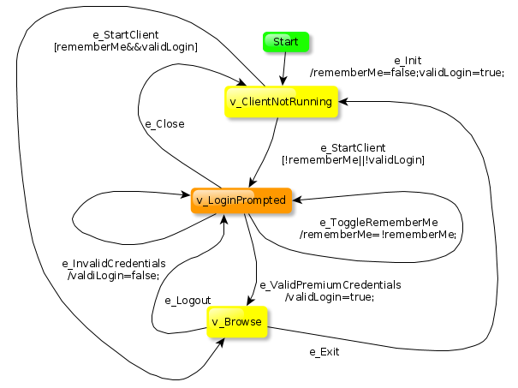
Automated test sequence generation
GraphWalker
Open source tool – using FSMs to drive test generation
Java & Python implementations
https://github.com/GraphWalker/graphwalker-project
https://github.com/spotify/python-graphwalker
Originated at Spotify
Examples:
http://graphwalker.github.io

Slide 62
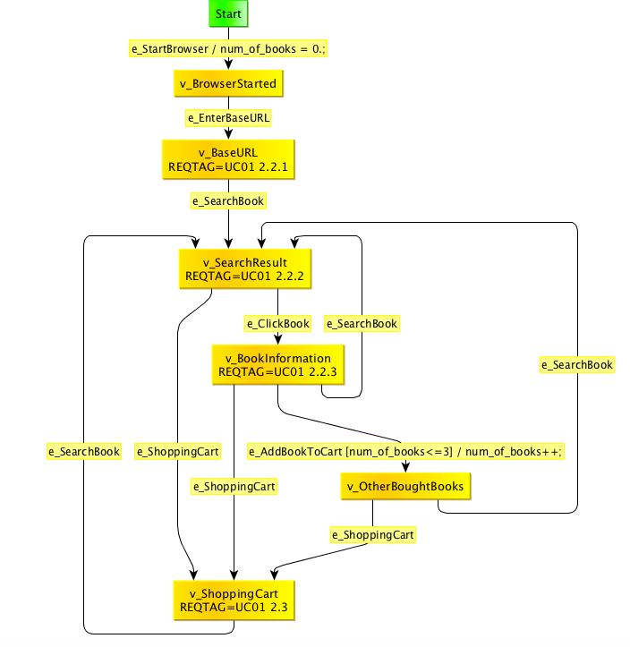
FSM: Bookstore Shopping Cart

Slide 63
GraphWalker Execution
$ graphwalker --reporter=Print:output=stderr ../graphwalker-example/java-amazon/src/main/resources/org/graphwalker/ShoppingCart.graphml
starting ShoppingCart-20180131141417
Begin step 'e_StartBrowser / num_of_books = 0.;'
Passed step 'e_StartBrowser / num_of_books = 0.;'
Begin step 'v_BrowserStarted'
Passed step 'v_BrowserStarted'
Begin step 'e_EnterBaseURL'
Passed step 'e_EnterBaseURL'
Begin step 'v_BaseURL'
Passed step 'v_BaseURL'
Begin step 'e_SearchBook'
Passed step 'e_SearchBook'
Begin step 'v_SearchResult'
Passed step 'v_SearchResult'
Begin step 'e_ShoppingCart'
Passed step 'e_ShoppingCart'
Begin step 'v_ShoppingCart'
Passed step 'v_ShoppingCart'
Begin step 'e_SearchBook'
Passed step 'e_SearchBook'
Begin step 'v_SearchResult'
Passed step 'v_SearchResult'
Begin step 'e_ClickBook'
…
GraphWalker generates paths of activity
The ‘hooks’ into external code used to:
invoke actions, and
verify the status at each step

Slide 64
Markov Chains

Slide 65
Markov Chains
Markov chains are extensions of finite state machines.
Definition: A Markov chain is a finite state machine with probabilities for each transition, that is, a probability that the next state is s_{j} given that the current state is s_{i}

Slide 66
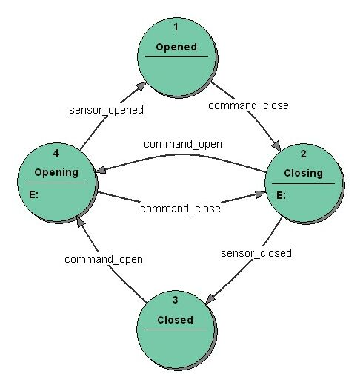
FSM/Markov Chain with probabilities for transitions
Garage Door Opener Example
If in state Opening, the probability of moving to state Open is 0.8 and 0.2 that you’ll move to state Closing
1.0
0.8
0.2
0.2
0.8
1.0
Wikipedia

Slide 67
Markov Chains
How do we use the probability in testing?
We still need to test all combinations
Probabilities provide important clues for load, stress, and reliability testing as as well as in simulations
0.8
1.0
0.2
0.2
1.0
0.8

Slide 68
State Charts

Slide 69
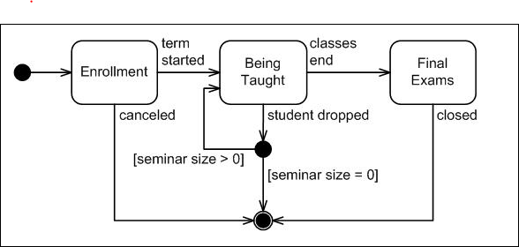
UML State charts/State diagrams
State charts are one of the diagrams used by Unified Modeling Language (UML)
Extend FSMs to be hierarchical to model large systems as a set of subsystems (using the charts), and then model the subsystems as a set of systems.
FSMs become unwieldy quickly

Slide 70
How do we turn UML into test cases?
Same approach as used with FSMs
Look at each state and each transition
Watch for invalid states
Notes:
You look at each state and each transition
So enrollment – cancelled and enrollment – term Started; then being taught and all of its possibilities.
Note that the not possible ones should be tested as well. Also remember that a that there is supposed to be no memory…so it doesn’t matter where it came from….if it does, it is not a state machine.

Slide 71
Grammars

Slide 72
Grammars
Grammars are a way of formally specifying the structure of languages
Backus-Naur Form (BNF) is a concise description of a grammar and the language it accepts
Grammars are used extensively in Computer Science in language and protocol processing
E.g., programming languages

Slide 73
Using Grammars
Grammars - used describe inputs to a system
However, grammars can also be used to generate test data
Use cases:
Language-based apps (compilers, interpreters, …)
Protocol-based implementations
Example : Triangle program
Input ::= Side Side Side
Side ::= Positive_number
Number ::= [0,1,2,3,4,5,6,7,8,9]+
Notes:
What is wrong with this

Slide 74
Grammars
Can also use grammars to model behaviors of systems
If you don’t know what grammars are,
You may want to do some introductory computer science reading on compilers and grammars. They are interesting and powerful.
Gentle introduction to BNF
https://www.youtube.com/watch?v=B4wMpOhOako

Slide 75
Practical Perspectives

Slide 76
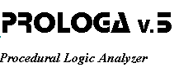
Decision Table Tools
Originally, tools helped in the specification of decision tables (e.g. spreadsheets)
Newer generation: support validation and implementation as well
PROLOGA (PROcedural LOgic Analyzer): PROLOGA is a set of methods and tools for the specification, validation and implementation of information systems, by means of decision tables
Statestep - allows formal definition of decision tables and can create executable code

Slide 77
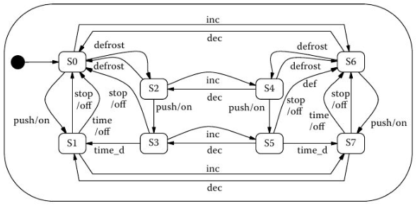
Toaster – Simple FSM
Automatic Model-based test generation from UML state machines from Model-based Testing for Embedded Systems, 2012, CRC Press

Slide 78
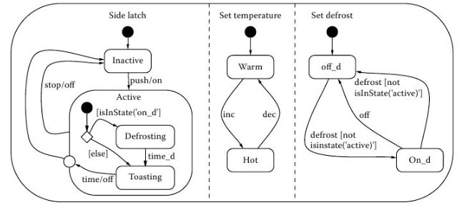
Toaster – Hierarchical State Machine
Automatic Model-based test generation from UML state machines from Model-based Testing for Embedded Systems, 2012, CRC Press

Slide 79
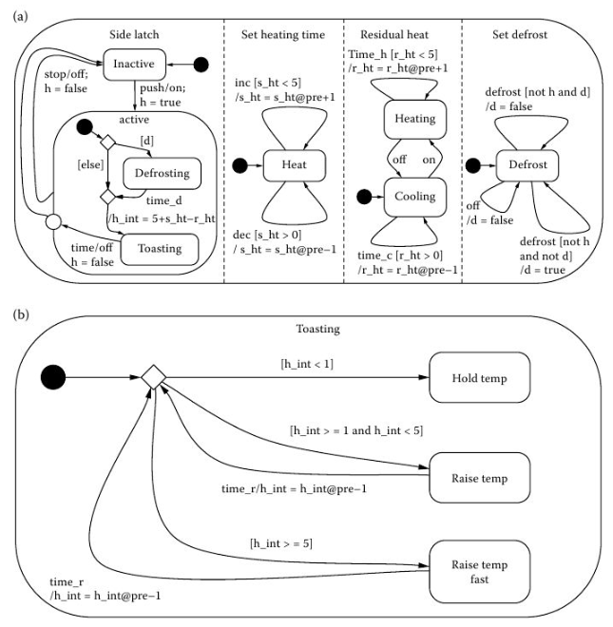
Toaster – Hierarchical State Machine with Variables
Automatic Model-based test generation from UML state machines from Model-based Testing for Embedded Systems, 2012, CRC Press

Slide 80
Model Coverage
Model Coverage is some percentage of a model that is included in a testing suite, for some coverage criteria
Testing suite is a collection of test cases
Coverage criteria is what is used to control the test-generation process

Slide 81
Model Coverage Criteria for FSM
All-States: for each state of the model, there is a test case that contains the state
All-Transitions: for each transition of the model, there is a test case that contains the transition
All-Events: the same for every event that is used in any transition
Depth-N: for each run of length at most N from the initial state, there is a test case containing this run as a subsequence
All-N-Transitions: for each run of length at most N from any state, there is a test case containing this run as a subsequence
All-Paths: all possible transition sequences have to be included in the test suite (typically considered infeasible)
Automatic Model-based test generation from UML state machines from Model-based Testing for Embedded Systems, 2012, CRC Press

Slide 82
Disadvantages of StateCharts
Model may be difficult to understand
Behavior of a complex system model in specific cases may not be readily apparent, requiring simulation of the model
Negative cases may be implicit in the model
Complex models may not afford systematic review
Much effort may be required to logically organize the structure of a model - distracting from the goal of capturing behavior in the model
https://statestep.com/statestepGuide.pdf

Slide 83
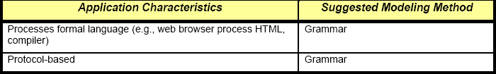
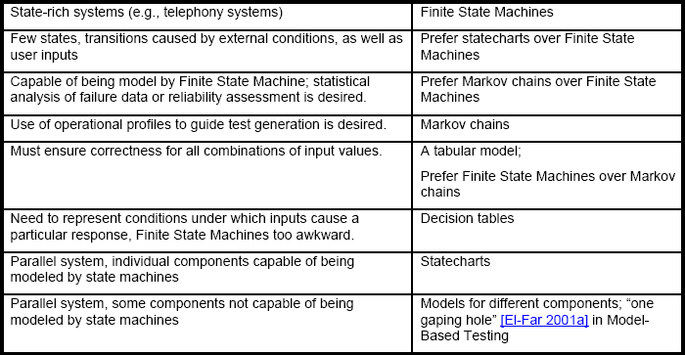
When to use different Modeling Methods
DACS Gold Practice Document Series GP-34 V 1.1 Model-Based Testing Last Updated: 10/20/03 - MODEL-BASED TESTING

Slide 84
Use of Models
Advantages?
Helps to identify all possible and valid states
Checking for consistency & completeness
Help to identify test cases
Help to identify requirements and design flaws
Potentially generate test cases automatically
Disadvantages?
Require formality and thought (is this a plus or a minus?)
Upfront time required to create
Scaling can be massive (e.g. 2^{n} for decision trees)

Slide 85
Models: Summary
All testers have a mental model of a system’s behavior
You can formalize and document this model and use it to both test the algorithms and specifications and to generate test cases
Finite State Machines,
Markov Chains,
Grammars,
Decision Tables,
State Charts

Slide 86
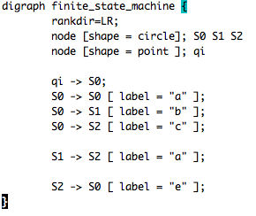
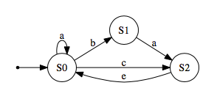
Background: Graph Drawing Tools
www.graphviz.org offers free, powerful graph drawing tools for arbitrary graphs including FSMs

Slide 87
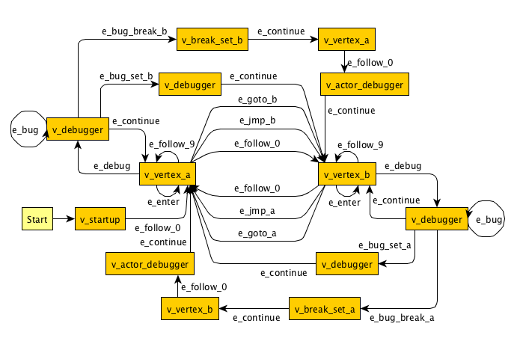
Background: Graph Editing Tool
https://www.yworks.com/products/yed offers a free desktop application that can be used to quickly and effectively generate diagrams

Slide 88

Questions?

